Slide 1
Graph Using Adjacency Matrix
A Project based on Graph Data Structure
Submitted by:
Abdul Wasiue – FA20-BCS-003
Rehber – SP19-BCS-024
Department of Computer Science
Submitted To: Dr Innayat –Ur- Rehman

Slide 2
A General Introduction to Graph and its Techniques

Slide 3
Unlike arrays or linked lists, a Graph is a non-linear/non-sequential or hierarchical data structure consisting of nodes and edges.
Graphs are mathematical structures that represent the pairwise relationship between the objects.
There are two major components of graph – Nodes/Vertices and Edges – Nodes are entities whose relationships are expressed using the edges while edges are the components that are used to represent the relationships between various nodes in a graph. An edge between two nodes expresses a one-way or two-way relationship between the nodes.
Graphs can be weighted and can be directed and undirected graph.

Slide 4
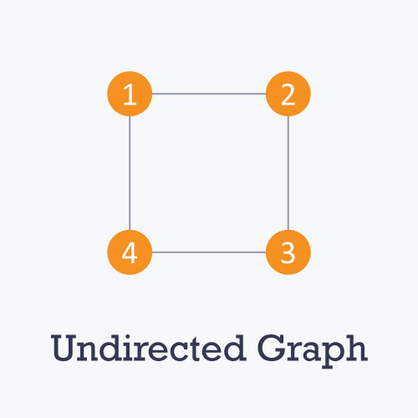
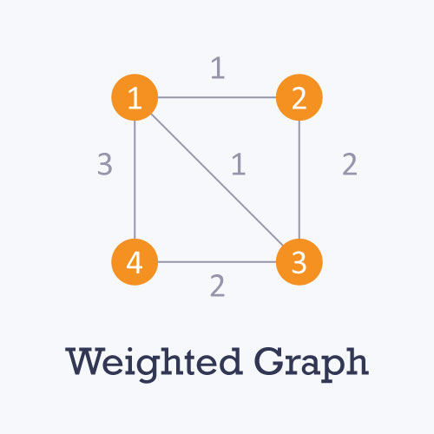
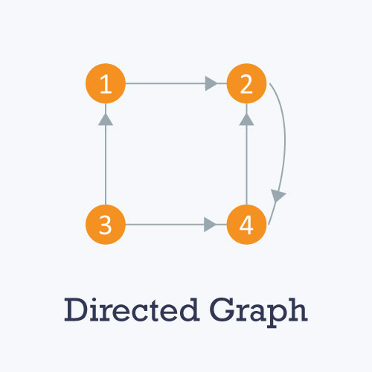

Slide 5

Representation of Graph Adjacency Matrix
Null (X)

Slide 6
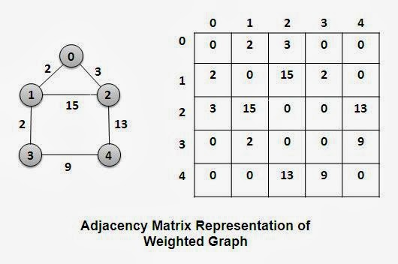
Adjacency Matrix
We can represent a graph in many ways. One of the way is to use adjacency matrix.
An adjacency matrix is a V X V binary matrix A – (where V is the number of vertices). Each element A_{u,v} is 1 if there is an edge between vertex u and v else A_{u,v} is 0.
We can modify the adjacency matrix for the weighted graph in which instead of storing 0 or 1 in A_{u,v} , the weight or cost of the edge will be stored.
In an undirected graph, if A_{u,v} is 1, then A_{v,u} is also 1, but in the directed graph, if A_{u,v} is 1, then A_{v,u} may or may not be 1.

Slide 7
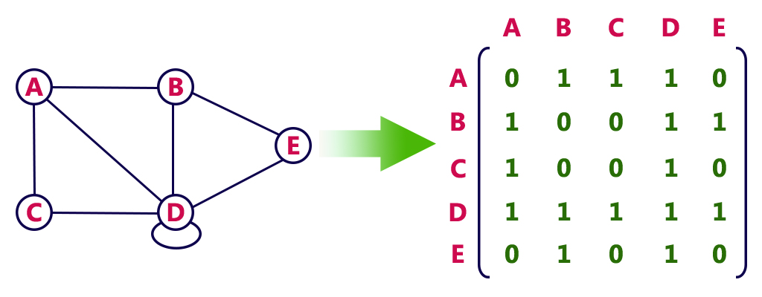

Slide 8
Tools and Technologies
C++ programming language
Visual Studio Code or Sublime Text

Slide 9
Functionality based Work Division
Student Name | Registration Number | Functionality
Rehber | SP19-BCS-024 | Adjacency Matrix using dynamic 2D-array BFS DFS Dijkstra’s Algorithm Prim’s Algorithm Kruskal’s Algorithm Other basic functionalities such as valid_edge, set and remove edge, union_set, etc
Abdul Wasiue | FA20-BCS-003 | Adjacency matrix using 2D-array BFS DFS Other functionalities such as set_edge, remove_edge, display_graph, etc

Slide 10
Graph Traversal Techniques

Slide 11
Depth-First-Search (DFS)
It is a recursive algorithm that uses the idea of backtracking.
It involves exhaustive searches of all the nodes by going ahead, if possible, else by backtracking.
This recursive nature of DFS, can be implemented using stacks.
The DFS algorithm works as follows:
Pick a source/starting node and push all its neighbors/adjacent nodes into a stack.
Pope a node from stack to select the next node to visit and push all its adjacent nodes in the stack.
Repeat this process until the stack is empty. However, ensure that the nodes are visited are marked. This will prevent us from visiting the same node again and again.
If we don’t mark the visited the nodes, we may end up in an infinite loop.

Slide 12
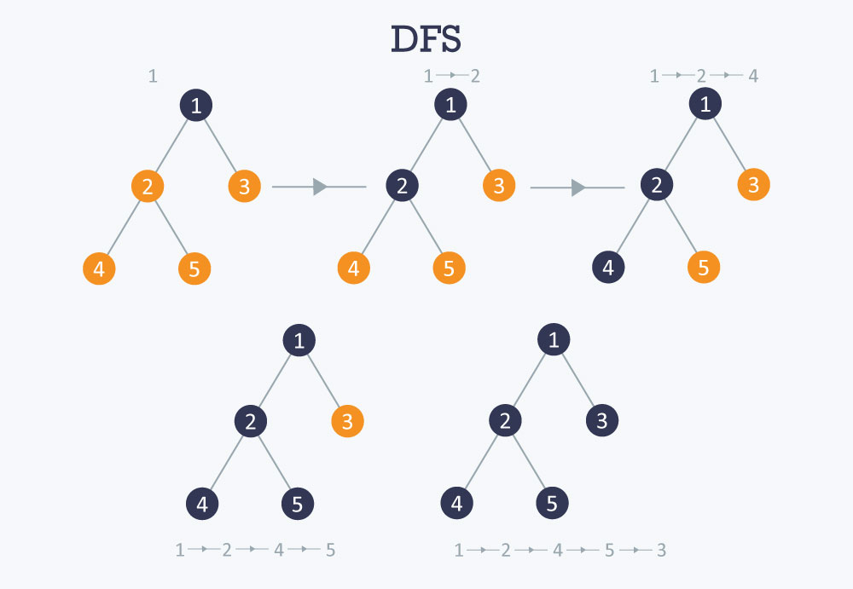

Slide 13
Breadth-First-Search (BFS)
It is a technique where we should start traversing from a selected node (source or starting node) and traverse the graph layerwise thus exploring the adjacent/neighbour nodes of the selected node.
The BFS algorithm works as follows:
Start by putting any one of the graph’s vertices at the back/rear end of a queue.
Take the front element of the queue and add it to the list of visited nodes.
Create a list of that vertex’s adjacent nodes. Add the ones which aren’t in the visited list to the back of the queue.
Keep repeating the steps 2 and 3 until the queue is empty.

Slide 14
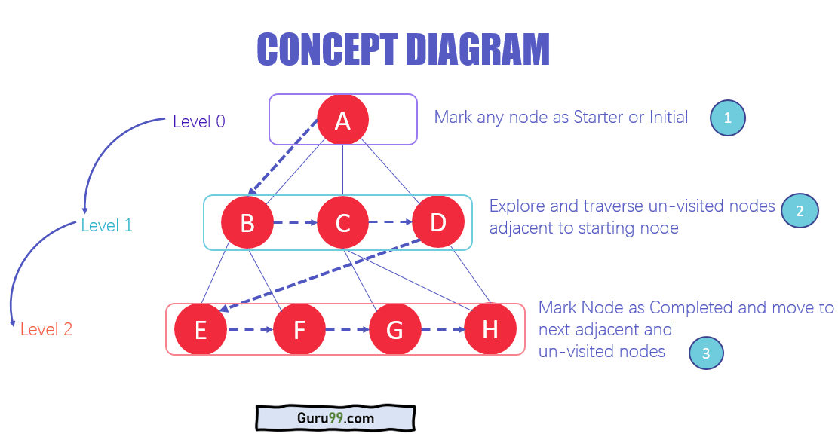

Slide 15
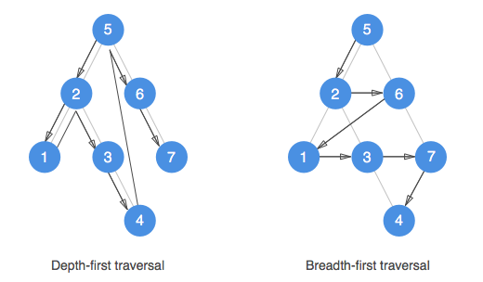
DFS vs BFS

Slide 16
Representation of Project
The above data structures and algorithms are used in the implementation of our project including Queue (Simple FIFO Queue and Priority Queue), dynamic array and stack (are also implemented from the scratch).
We’ll use a 2D matrix for storing the graph in the form of adjacency matrix. All the data is taken from user like the cost of an edge etc. Then we’ll use the different traversal and shortest path algorithms to find the shortest path and the cost of the shortest path between the two nodes.

Slide 17
This function sets the element A_{u,v} and A_{v,u} to 0, i.e., A[u][v] = 0 or 1
Functionalities
Constructor
Defines the size of the 2D matrix, Initializes the matrix to 0, and three dynamic arrayss
visited_nodes list to 0
mst_list to 0
Distances array to INT_MAX
RemoveEdge

Slide 18
Display
This function just displays the graph – traverse each element of the adjacency matrix and prints it to the screen.
SetDistance
This function sets the user-defined cost of the edge, i.e., A_{u,v} to cost or A[u][v] = cost

Slide 19
BFS
DFS
dijkstra_shortest_path
prims_MST
kruskals_MST
These above defined functions will be used for finding the shortest path and the cost of the shortest path with the help of their respective algorithms. Some functions of stack and queue will also be used as utility/helper functions in the implementation of the above functions. So, there are a lot of functionalities will be implemented in this project.

Slide 20
THANK YOU!

